Slide 1
Decision Trees

Slide 2
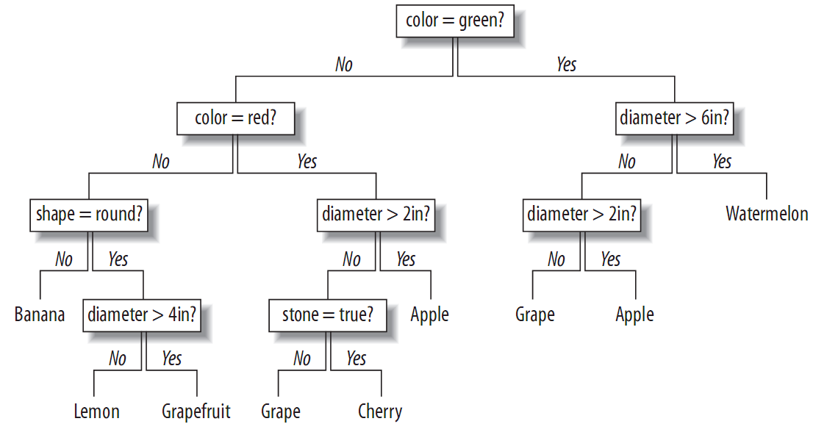
Decision Tree Learning
A classification method
Models are easy to interpret
  Easy to understand the reasoning process
  Easy to convert to series of if-then statements

Slide 3
Online Application Example
An online application that offers a free trial
Choose to upgrade to a basic or premium service after trial
User information are from
  Questionnaire in the application form
  Server logs: the site that referred them, their geographical location, how many pages they viewed before signing up, etc

Slide 4
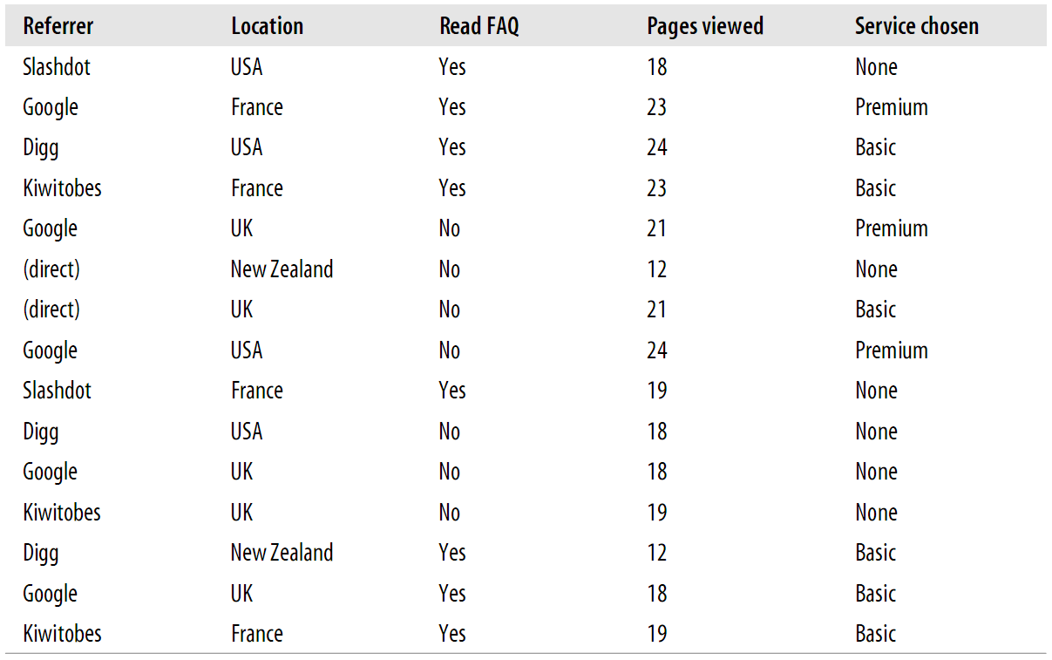
User Behavior and
Final Purchase Decision

Slide 5
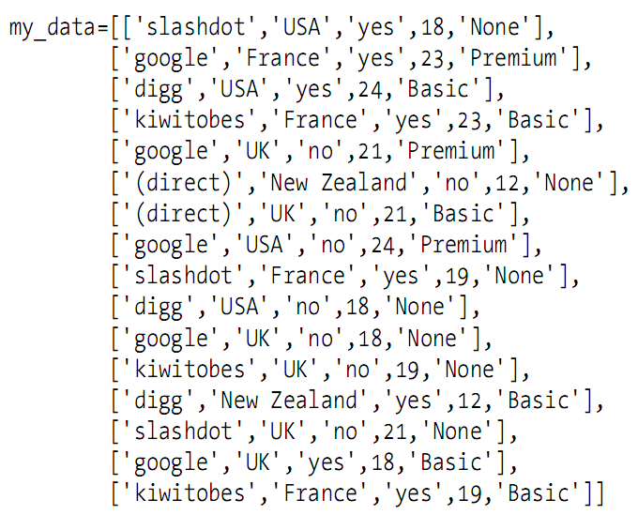
User Data Presentation
Download: http://kiwitobes.com/tree/decision_tree_example.txt

Slide 6
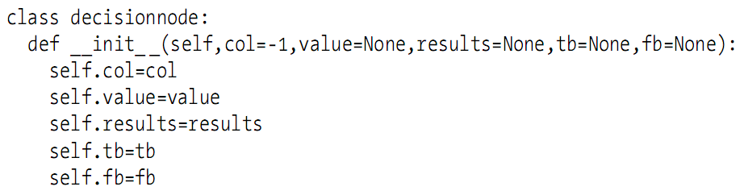
Decision Trees
One of the simpler machine-learning methods
Looks like a series of if-then statements arranged into a tree

Slide 7
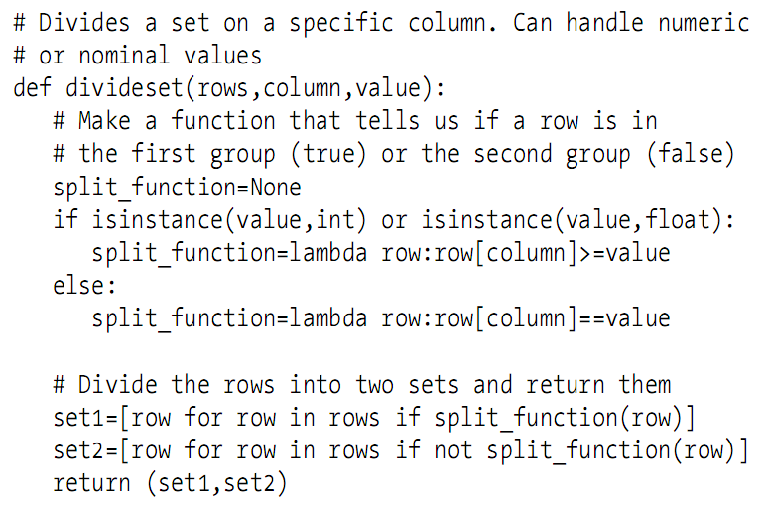
CART
CART: Classification and Regression Trees
Considering all the observations in the data table, choose the best variable to divide up the data

Slide 8
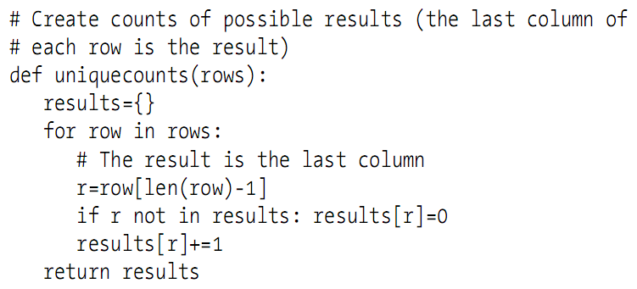
The Best Split, How?
Need a way to measure how mixed a set is
Two possible solutions
  Gini impurity
  Entropy

Slide 9
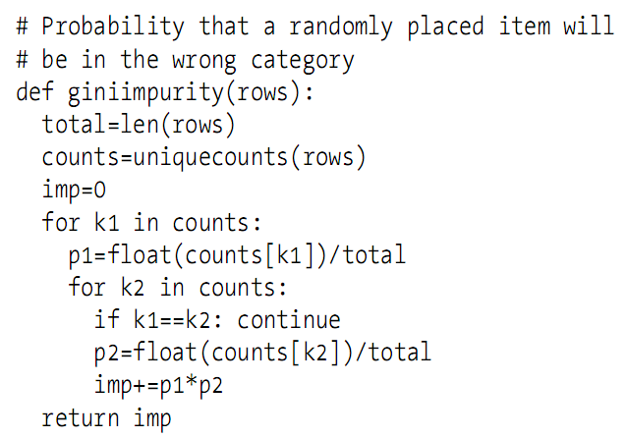
Gini Impurity Function

Slide 10
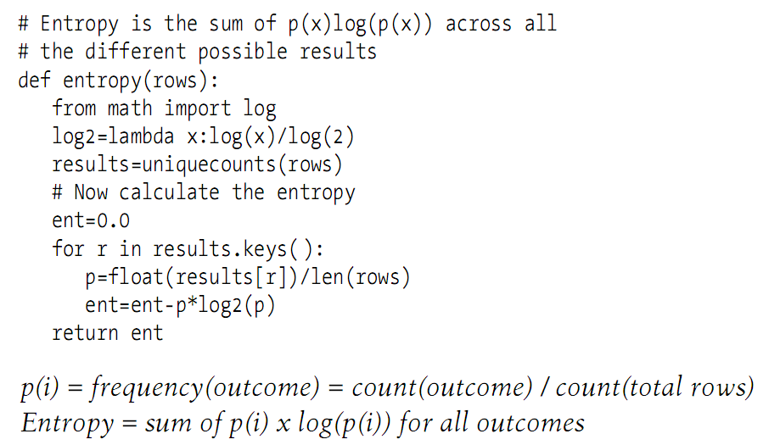
Entropy Function

Slide 11
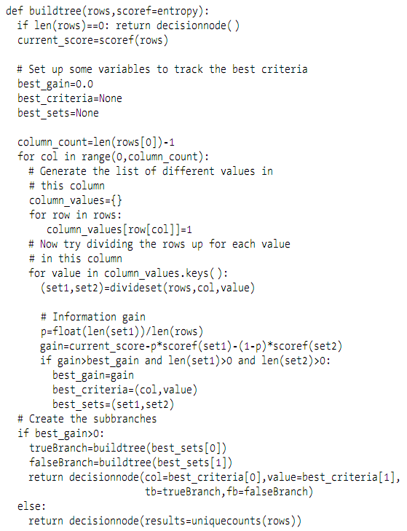
Recursive Tree Building

Slide 12
Problem of Decision Trees
Overfit problem
  Become too specific to the training data
  Give answer being more certain than it really is
Solution: pruning
  Build the entire tree as described
  Try to eliminate superfluous nodes

Slide 13
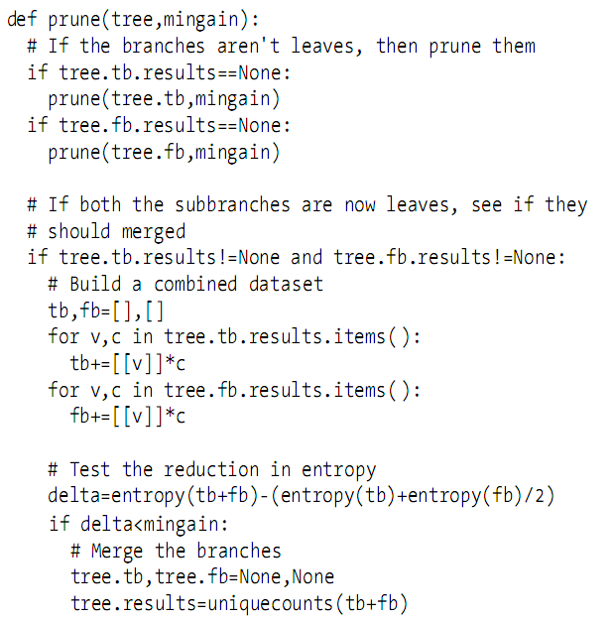
Pruning Process
Checking pairs of nodes that:
  Have a common parent
  See if merging would increase the entropy by less than a specified threshold

Slide 14
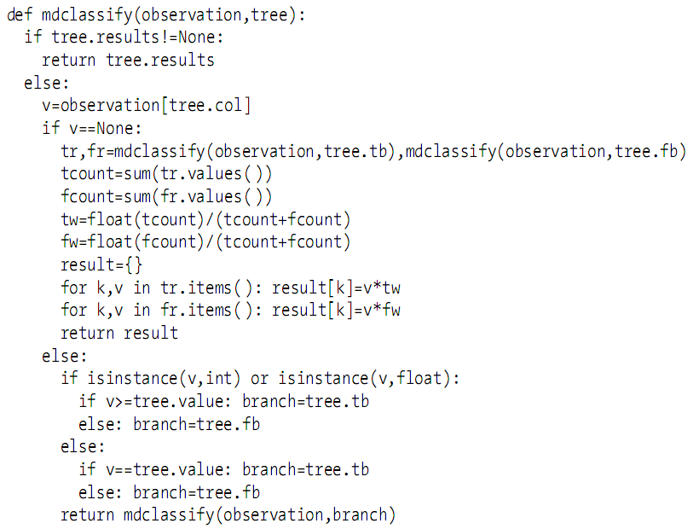
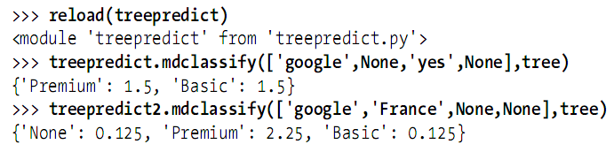
Deal with Missing Data
from: http://en.wikipedia.org/wiki/Correlation

Slide 15
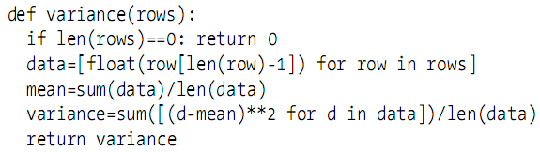
Deal with Numerical Data
Use decision trees directly on numerical data
  Treat all numbers as categorical?
  Use variance instead of Gini impurity or entropy!

Slide 16
Summary
Advantages
  Easy to interpret a trained model
  Work with both categorical and numerical data
  Not really need to normalize data
Drawbacks of decision trees
  Can’t be used effectively on datasets with many possible outcomes
  Numerical data can only create greater-than/less-than decision points, no exact answers

